Slide 1
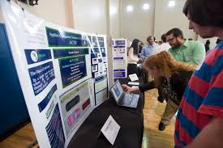

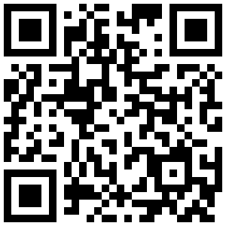


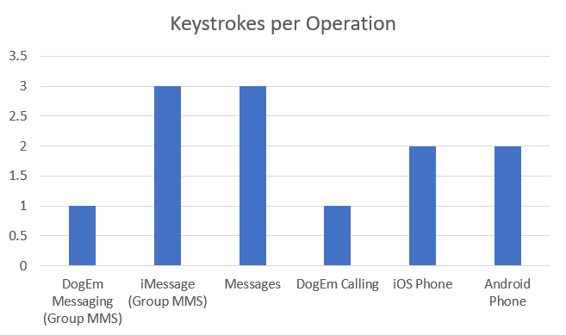



DogEm
SP-04
Abstract
Results
Conclusions
This template describes the formatting guidelines for CCSE Computing Showcase Day posters. The assigned poster number must be in the left top corner of the in Arial 120 bold. The abstract should be no longer than 120 words summary of the entire project. You must include assigned poster number in the left top corner of the poster http://ccse.kennesaw.edu/docs/fall2016c-day.html
Section headings: Arial 48 bold
Section text Arial 28 or Arial 20 for references., contacts, etc
DogEm App: The team developed a final product that is capable of calling, texting, and emailing a series of contacts repeatedly with minimal user intervention.
Website: We have a GitHub pages site that contains information about our app, our team, the project, and CS 4850 that can be accessed via this link: DogEm App
We have a source code directory linked on our website that allows users to view group members' prototypes, a final prototype, and the final product.
Findings:
The DogEm App is able to call and send messages at a considerably faster rate (2-3x faster according to our testing) by using a semi-automated approach.
Briefly review your research questions and the results of your research.
Introduction
In two-three paragraphs describe the background of your project. You can include graphics to help the viewer understand the project.
Acknowledgments
Dr. Sharon Perry
Research Question(s)
Contact Information
List your research questions here. Do not include more than five questions. You can also include additional sections such as: Background, Project Goals, Objectives, Data Collection, Data Analysis, and Recommendations.
Zane Atkinson zatkins1@students.kennesaw.edu
Chloe Chung cchung8@students.kennesaw.edu
Melissa Iniestra miniestr@students.kennesaw.edu
Deo lntshakal A Nzeng dintshak@students.kennesaw.edu
Joshua Willson jwillso2@students.kennesaw.edu
Tools
References
Provide references here.
You can use the departmental logo instead of the college logo. The official logo policy is available at http://styleguide.kennesaw.edu/logo-policy/unacceptable-variations.php
Author(s)
Advisors(s)

